Slide 1
Game Engines Workshop
How to develop using game engines by DNAngeluS

Slide 2
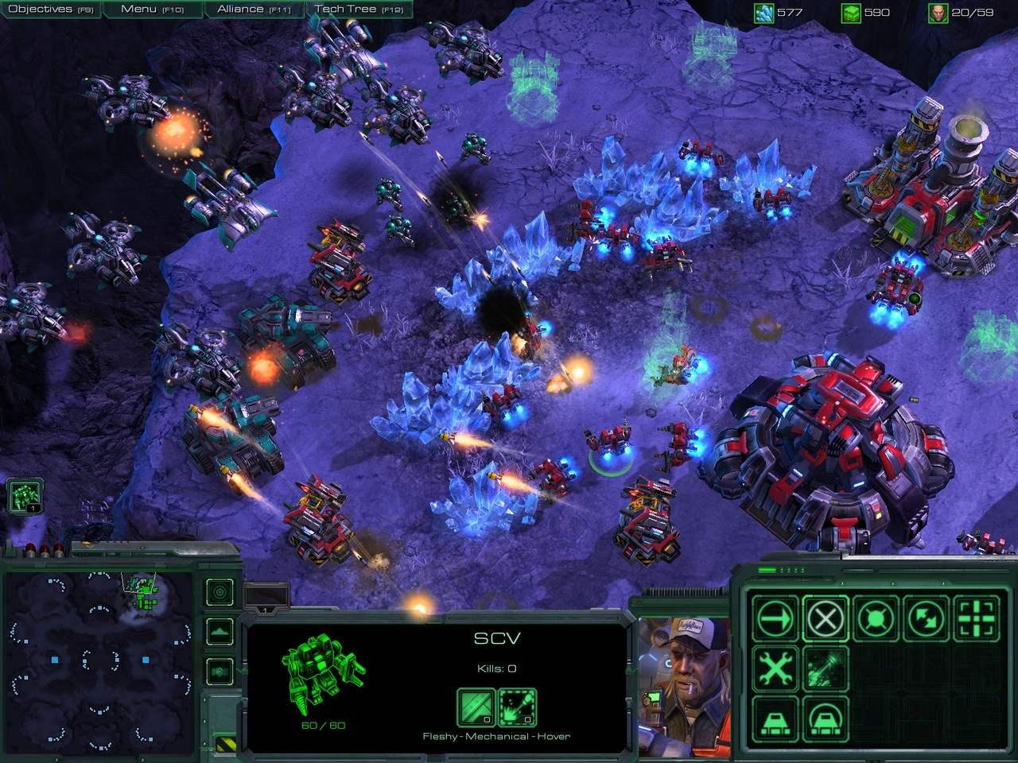
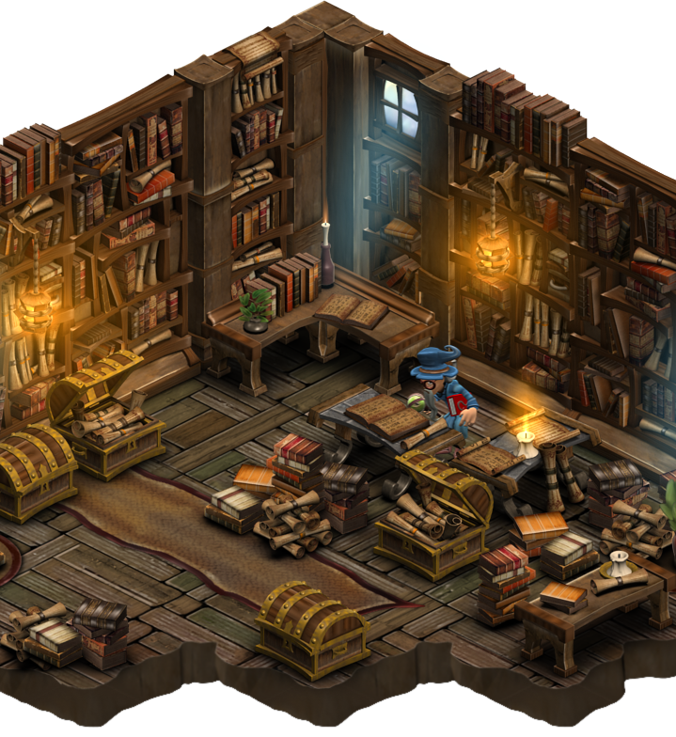
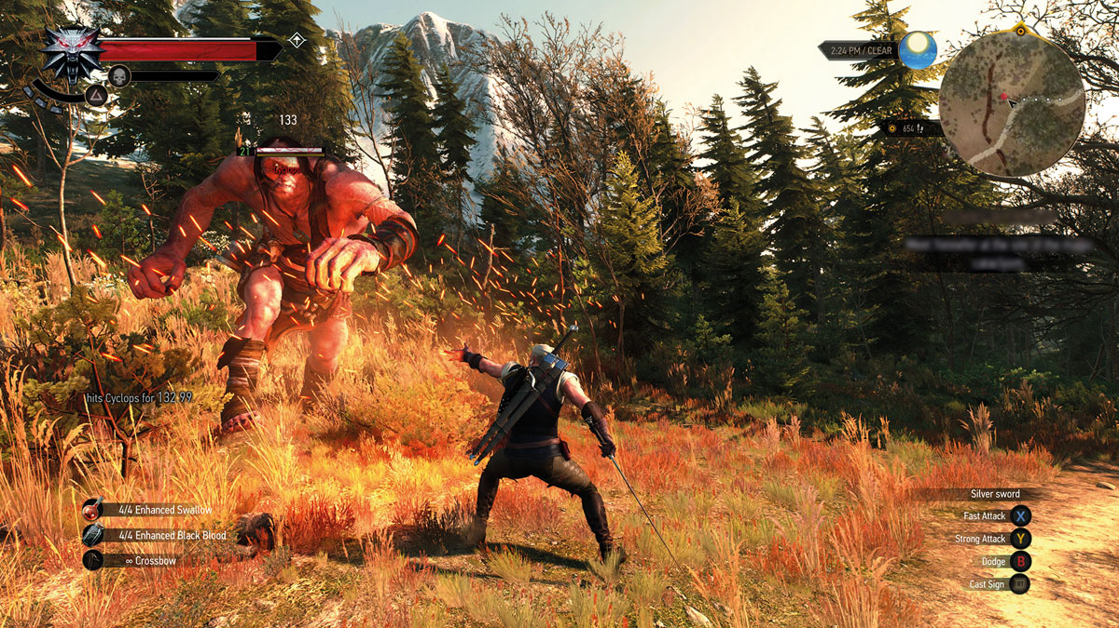
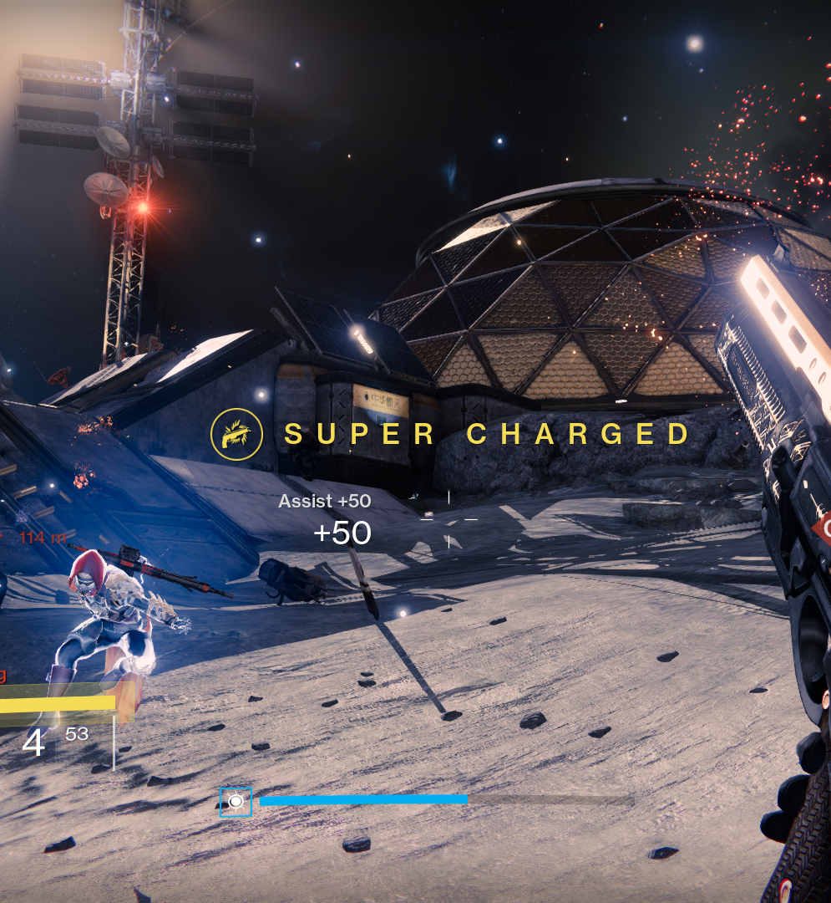
What is a Game?
Notes:
The activity of learning and mastering are the heart of what we call “fun”
-----------
La actividad de aprender y perfeccionar esta en el Corazon de lo que llamamos divertido.

Slide 3
What is a Game?
“Interactive experience that provides the player with an increasingly challenging sequence of patterns which he or she eventually masters”. A theory of Fun for games, Raph Koster [1]
Notes:
(Spanish quote)
“Una experiencia interactiva que prove al jugador una secuencia de patrones incrementalmente mas desafiantes que eventualmente perfecciona.”
Ref:
[1] Raph Koster. A theory of Fun for Games Design. Phoenix, AZ: Paraglyph, 2004

Slide 4
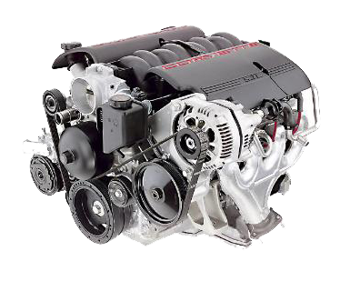
What is a Game Engine?
Notes:
Mid-1990 -> Rising of “Game Engine” term in reference to FPS like Doom by Id Software.
Architected with well-defined separation between its CORE Components and the ART assets game worlds and rules of game.
----------------
Mediados de los 90’ -> El término Game Engine se empieza a hacer popular en los juegos de tipo FPS como el Doom de Id Software.
Fue uno de los primeros Software con una arquitectura bien definida que separaba sus componetes basicos (CORE) de sus reglas de juego, components artisticos o niveles (mundos).

Slide 5
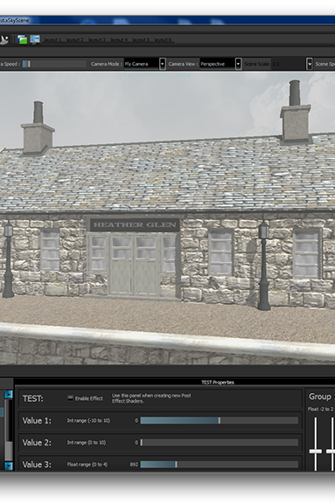
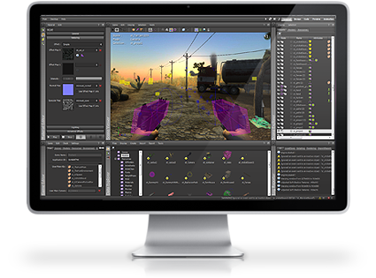
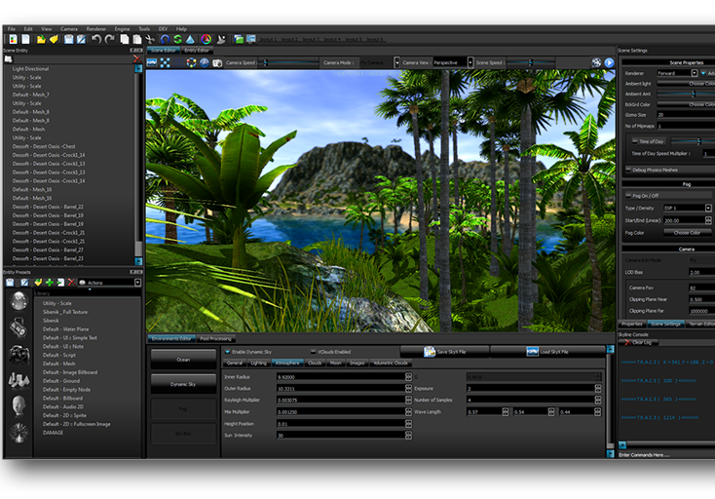
Game engines
“Software that is extensible and can be used as the foundation for many different games without major modification”. Game Engine Architecture, Jason Gregory [2]
Notes:
(Spanish Qoute)
Un Software que puede ser extendido y usado como base para muchos juegos diferentes sin mayors modificaciones.
Ref:
[2] Jason Gregory. Game Engine Architecture. Natick, MA: A K Peters, Ltd. 2009

Slide 6
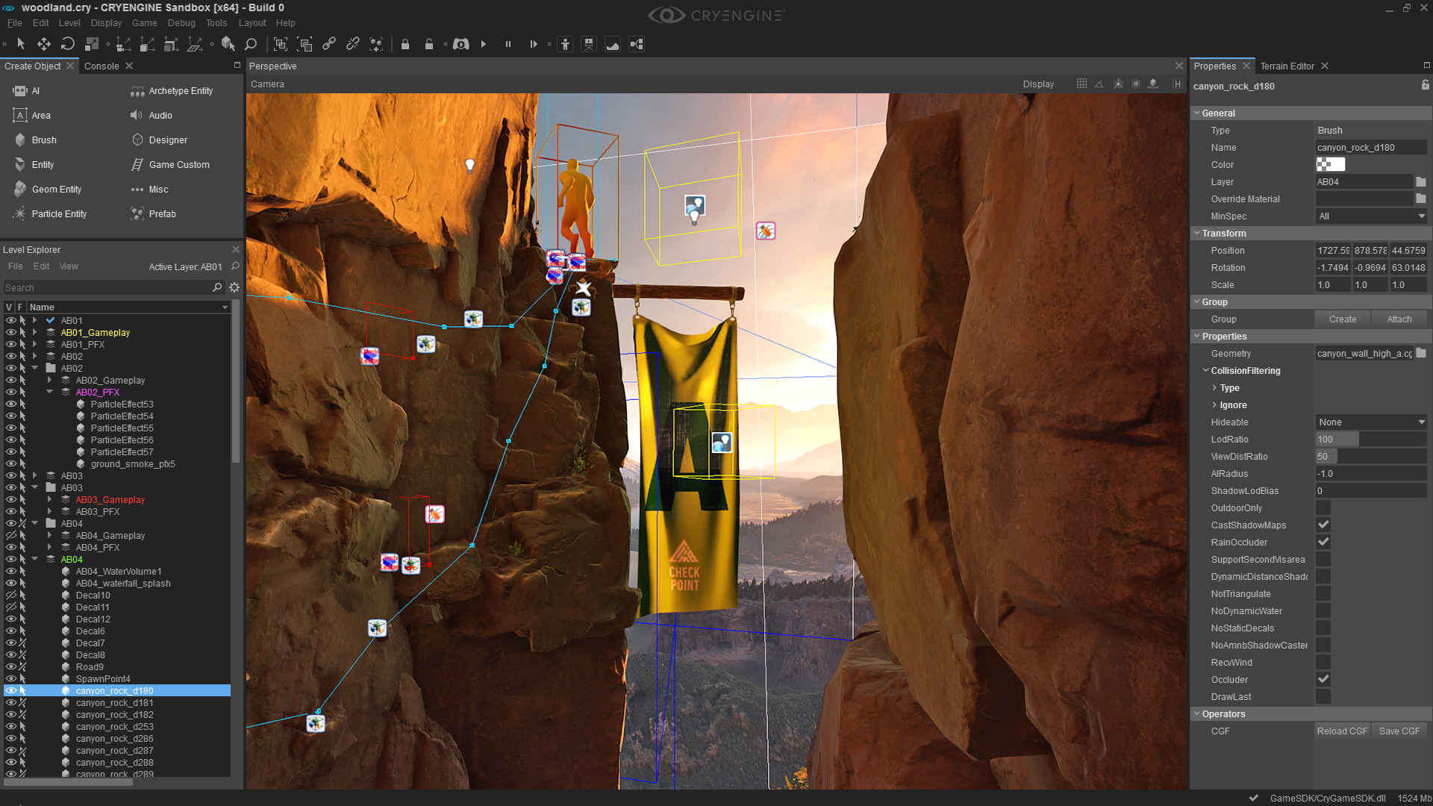
Game Engine or Level Editor

Slide 7
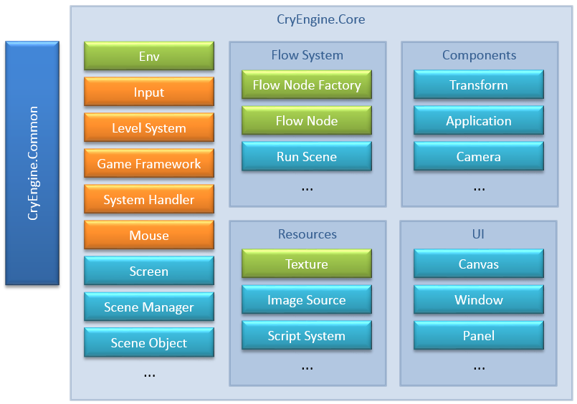
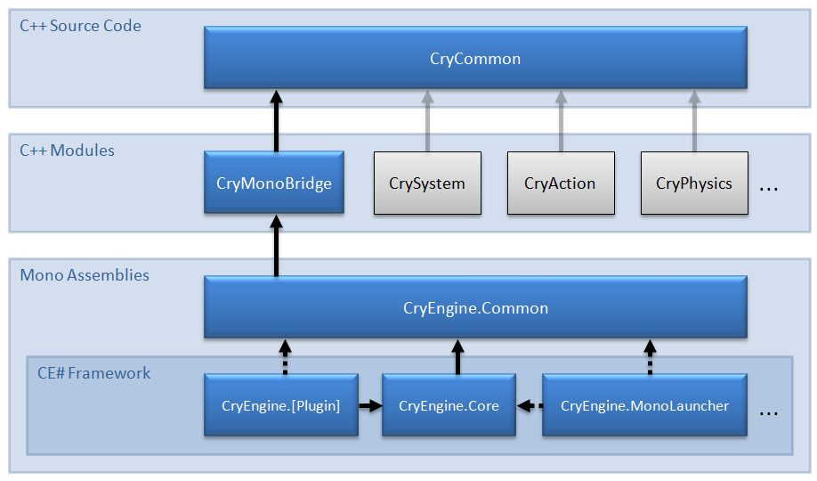
Game Engine vs Level Editor
Software used to design levels, maps, campaigns, etc.
“A ‘level editor’ is a 3D tool for game level design and tuning”, Game Engines: Tools for Landscape Visualization and Planning?, Adrian HERWIG and Philip PAAR [3]
Notes:
(Spanish Quote)
Un editor de niveles es una herramienta 3D para diseñar y ajustar un nivel (o mapa) de un juego.
Ref:
[3] http://www.kolleg.loel.hs-anhalt.de/studiengaenge/mla/mla_fl/conf/pdf/conf2002/42herwig.pdf

Slide 8



Game Engies

Slide 9
CryEngine V 5.3

Slide 10
Build Project

Slide 11
Download & Install
https://www.cryengine.com
https://www.cryengine.com/tutorials
https://www.cryengine.com/marketplace
http://docs.cryengine.com/display/SDKDOC1/Home

